Slide 1
Existence of Non-measurable Set
Hubert Chan
[O1 Abstract Concepts]
[O2 Proof Techniques]

Slide 2
Some Quesions
1. Suppose A is a subset of a 1 x 1 square.
Is the area of A always between 0 and 1?
2. Suppose A is a subset of [0,1].
If a point x is picked from [0,1] uniformly at random,
is Pr[x lies in A] always well-defined?

Slide 3
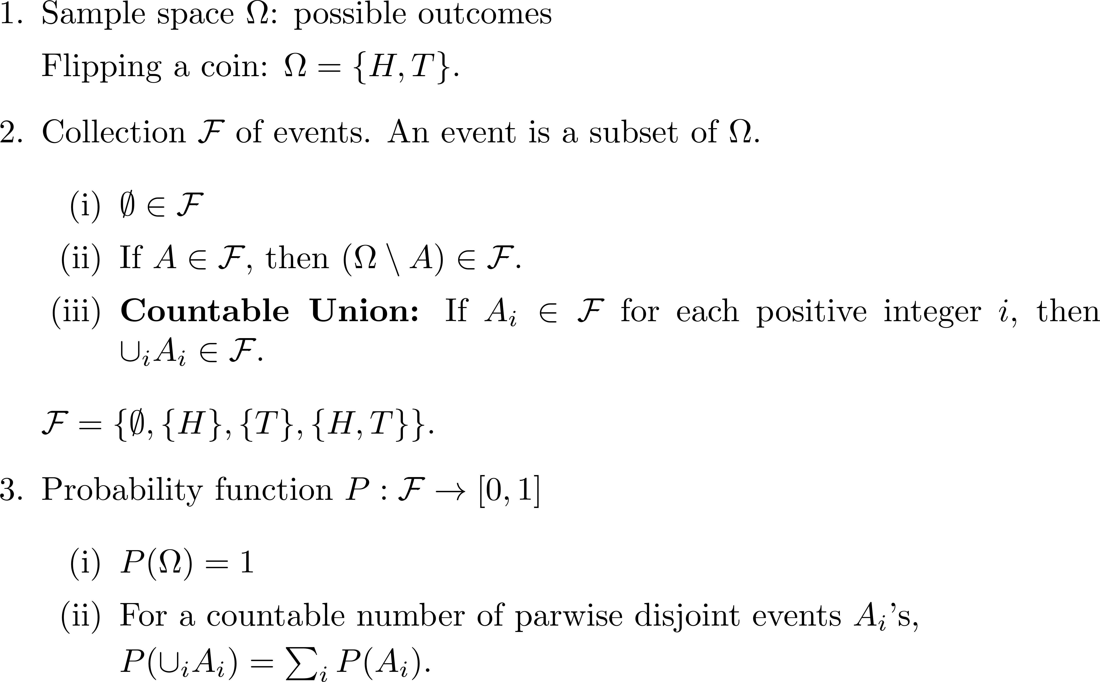
Formal Definition [O1]

Slide 4
Warmup: Infinite Sample Space
Does there exist a uniform distribution on ?
No. Suppose on the contrary, for all .
Since is countable, we can apply the sum rule.
If , then .
If , then .
Both cases contradict .

Slide 5
Review: Axiom of Choice
Given a collection of non-empty subsets, there exists a representative function that elects a representative element from each subset.

Slide 6
Probability as a Measure
Pick a point uniformly at random from the interval [0,1].
What is the probability that you picked a point from interval [a,b]? b – a
Pick a point uniformly at random from the unit square area.
What is the probability that you picked a point from a part of area s? s
0
a
b
1
s
1
1

Slide 7
Main Result: Non-Measurable Sets
Is there a subset in the interval [0,1], such that the “length” of the subset cannot be defined?
“Cannot be defined”: the length can not be any number c, for 0 ≤ c ≤ 1.
Is there a shape inside the square, such that the area of the shape cannot be defined?
0
?
1
?
1
1

Slide 8
Warm-Up
Can we sample a positive integer uniformly at random?
Can we pick a rational number from [0,1] u.a.r.?

Slide 9
Why can’t we pick a rational from [0,1] u.a.r.?
Define A_{q} := {q} for each rational q in [0,1]
How many rationals in [0,1]? Infinite. Countable?
Can both (i) and (ii) hold if all A_{q}’s have the same probability?

Slide 10
How do we pick real from [0,1] u.a.r.?
Note that Ω = [0,1) is uncountable. How do we pick numbers from Ω uniformly at random?
What does it mean by “uniformly at random”?
Intuition:
For two subsets A and B, if we can get B (or A) by shifting A (or B), then it should hold that Pr[A] = Pr[B].

Slide 11
Cyclic Shifting
Take Ω = [0,1). We “identify” 1 with 0.
Cyclic shifting: a bijective function f_{s}: Ω → Ω, such that
0 ≤ s < 1 and
f_{s}
f_{s}
Examples:
f_{0.2}( [0.5,0.6] ) = [0.7,0.8].
f_{0.5}( [0.7,0.8) ) = [0.2,0.3).

Slide 12
Uniformly at Random [O1]
A selection from Ω is uniformly at random if it satisfies the following condition:
For two subsets A, B, if there exists a cyclic shifting function from A to B (and vice versa), then Pr[A] = Pr[B].

Slide 13
Problem
Sample space: Ω = [0,1). (We omit 1 for convenience.)
Event: subset of numbers in Ω, e.g. interval [a,b].
Question:
If we pick a real number from Ω uniformly at random, is it true that for any subset S⊆Ω, Pr[S] is well defined?
Example:
If S is an interval [a,b], then Pr[S] = b-a.

Slide 14
Recall The Problem [O2]
Question:
If we pick a real number from Ω uniformly at random, is it true that for any subset S ⊆ Ω, Pr[S] is well defined?
In the remaining part, we will construct a subset M of Ω, for which Pr[M] is undefined, i.e., for any number p ∊ [0,1], we have Pr[M] ≠p.
If we try to assign a value to Pr[M], we will violate properties of probability.
Is it magic?

Slide 15
Equivalence Classes
Definition of relation “〜”:
x〜y ⇔ y-x ∊ Q
Two numbers are related if their difference is rational.
Note that “〜” is an equivalence relation. Let C be the collection of all equivalence classes of “〜”.
Hence, C gives a partition of Ω.

Slide 16
Equivalence Classes: C_{x}
Define Q = Q ⋂ Ω. Then Q contains all rational numbers in [0,1).
Let equivalence class C_{x} be all the numbers y in Ω, such that x〜y. Then C_{x} = {x⊕q : q ∊ Q }, where
Pr[C_{x}] = 0
⋃_{A∊C} A = ⋃_{x∊Ω} C_{x}

Slide 17
Recall Axiom of Choice
Suppose we have a collection C of non-empty sets in Ω
S₁, S₂, S₃, …
Each set can be finite set or infinite set
The number of sets can be finite or infinite (even uncountable)
Then, we can pick a representative from each set:
x₁, x₂, x₃, …
Each x_{i} is an element of S_{i}
Formally, there exists f: C → Ω, such that for each A ∊ C,
f(A) ∊ A

Slide 18
Candidate for Non-measurable set
M = { f(A): A ∊ C } the set of representatives of equivalence classes
Since there are “many” equivalence classes, we need Axiom of Choice to choose representatives.
M is uncountable
We want to show that it is impossible to define a probability for M.

Slide 19
Strategy
We want to construct a countable collection of pairwise disjoint subsets M₀, M₁, M₂, … such that ⋃_{i} M_{i}= Ω and if Pr[M] exists, then for all i, Pr[M_{i}] = Pr[M].
Why would this cause contradiction?

Slide 20
Construction of M_{q}’s
Given M, for each q in Q (q is a rational number in Ω), define M_{q} = {x ⊕ q: x ∊ M}.
By uniformity, we have Pr[M] = Pr[M_{q}] for any q in Q.
{M_{q}}_{q∊Q} is countable.

Slide 21
Construction of M_{q}’s
M_{q}’s are pairwise disjoint.
Proof.
Assume M_{q} ⋂ M_{p}≠ ∅. Then, there exists a number x ∊ M and y ∊ M such that x ⊕ q = y ⊕ p, which implies x〜y.
Since x, y are both in M, then we know x = y, and consequently q = p, which indicate M_{q} = M_{p}.

Slide 22
Construction of M_{q}’s
⋃_{q} M_{q}= Ω.
Proof.
For any x ∊ Ω, it’s in an equivalence class with representative u, such that x〜u.
Hence there exists q ∊ Q, such that x = u ⊕ q, and x ∊ M_{q}.

Slide 23
Contradiction
Recall that for pairwise disjoint sets M_{i}’s, if the collection of all M_{i}’s is countable, then Pr[{M_{i}}] = ∑_{i} Pr[M_{i}].
If Pr[M] = 0, then Pr[⋃_{i} M_{i}] = 0, which contradicts to Pr[⋃_{i} M_{i}] = Pr[Ω] = 1.
If Pr[M] > 0, then Pr[⋃_{i} M_{i}] = ∞, which contradicts to Pr[⋃_{i} M_{i}] = Pr[Ω] = 1.

Slide 24
Conclusion
It is impossible to divide up a sample space into countably infinite number of equally probably events.
Assuming Axiom of Choice, there exists a non-measurable set.
Do you know how to show there is a subset S in a 1 x 1 square such that the area of S is undefined?

